Slide 1
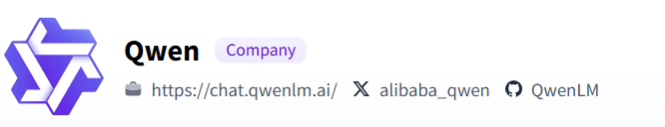

YES!
NathMath @ Bilibili

Slide 2
先说结论
· QWQ 是地表开源推理模型中的最强
· 仅仅32B大小，Q4版本仅需16G显存
· 数学/逻辑推理开源模型灭霸的存在
· 编程/代码转写开源模型第一梯队*
· 翻译/文本推理开源模型第一梯队
· 不擅长小说/文学类文本写作/角色扮演
NathMath @ Bilibili

Slide 3
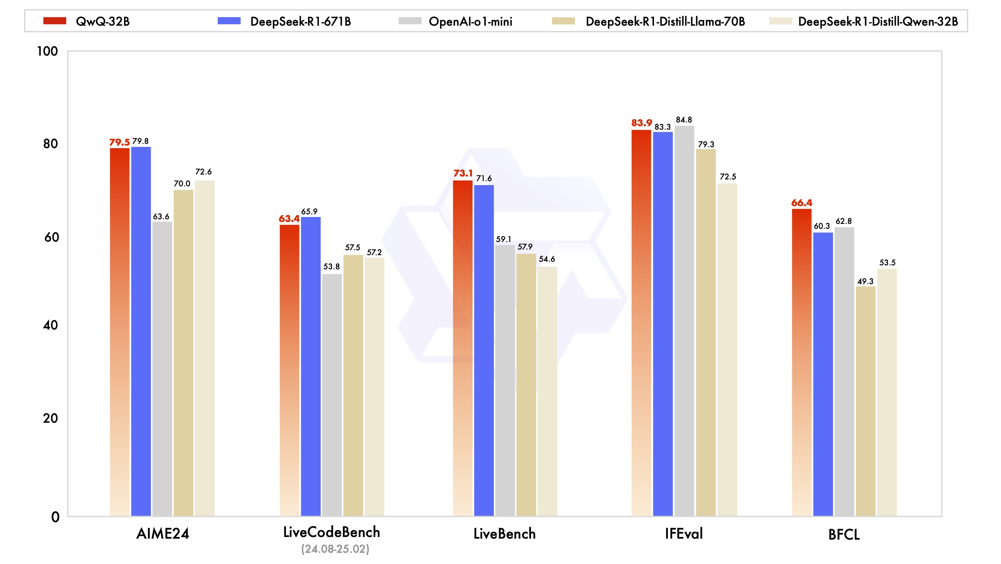
官方跑分
NathMath @ Bilibili

Slide 4
内容导视
· 怎么下载？
· LM Studio报错解决方法 (独家)
· 数学/逻辑推理评测和建议
· 编程/代码转写评测和建议
· 翻译/文本推理评测和建议
NathMath @ Bilibili

Slide 5
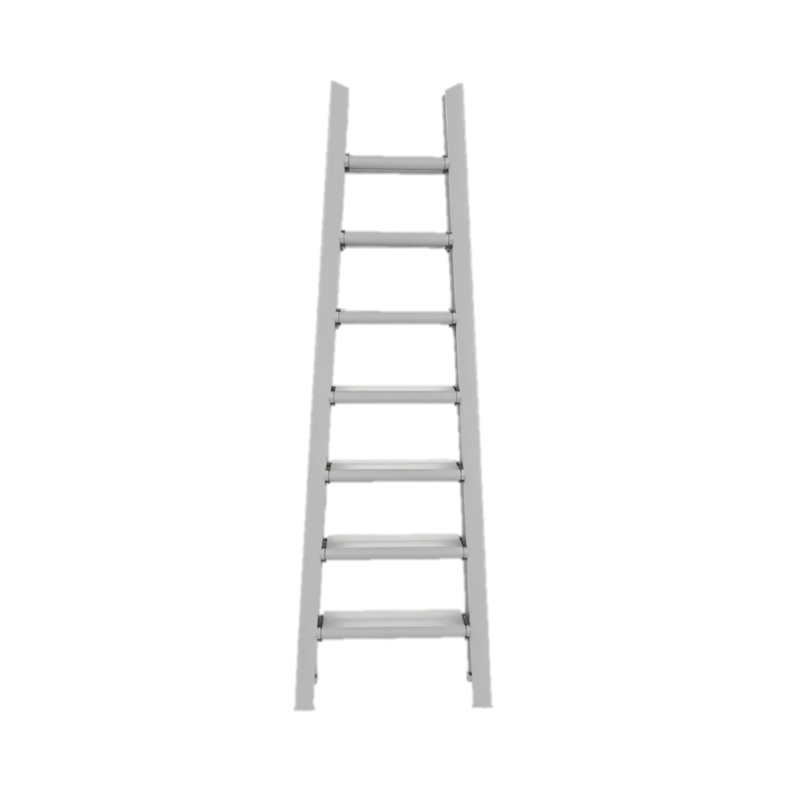
怎么下载？
Hugging Face连接 官方GGUF：
https://huggingface.co/Qwen/QwQ-32B-GGUF
HF镜像站 官方GGUF：
https://hf-mirror.com/Qwen/QwQ-32B-GGUF
Hugging Face在线试用：
https://huggingface.co/spaces/Qwen/QwQ-32B-Demo
NathMath @ Bilibili

Slide 6
LM Studio报错解决方法
报错：
Failed to parse Jinja template: Parser Error: Expected %}
token. MultiplicativeBinaryOperator !== CloseStatement.
看教程找到Jinjia Script，
替换掉原来不正确的脚本，为UP的PPT里的脚本。
(这个演示文稿可以在评论区/视频简介下载到)
NathMath @ Bilibili

Slide 7
LM Studio报错解决方法
{%- if tools %}
{{- '<|im_start|>system\n' }}
{%- if messages[0]['role'] == 'system' %}
{{- messages[0]['content'] }}
{%- else %}
{{- 'You are a helpful assistant.' }}
{%- endif %}
{{- "\n\n# Tools\n\nYou may call one or more functions to assist with the user query.\n\nYou are provided with function signatures within <tools></tools> XML tags:\n<tools>" }}
{%- for tool in tools %}
{{- "\n" }}
{{- tool | tojson }}
{%- endfor %}
{{- "\n</tools>\n\nFor each function call, return a json object with function name and arguments within <tool_call></tool_call> XML tags:\n<tool_call>\n{\"name\": <function-name>, \"arguments\": <args-json-object>}\n</tool_call><|im_end|>\n" }}
{%- else %}
{%- if messages[0]['role'] == 'system' %}
{{- '<|im_start|>system\n' + messages[0]['content'] + '<|im_end|>\n' }}
{%- else %}
{{- '<|im_start|>system\nYou are a helpful assistant.<|im_end|>\n' }}
{%- endif %}
{%- endif %}
{%- for message in messages %}
{%- if (message.role == "user") or (message.role == "system" and not loop.first) or (message.role == "assistant" and not message.tool_calls) %}
{{- '<|im_start|>' + message.role + '\n' + message.content + '<|im_end|>' + '\n' }}
{%- elif message.role == "assistant" %}
{{- '<|im_start|>' + message.role }}
{%- if message.content %}
{{- '\n' + message.content }}
{%- endif %}
{%- for tool_call in message.tool_calls %}
{%- if tool_call.function is defined %}
{%- set tool_call = tool_call.function %}
{%- endif %}
{{- '\n<tool_call>\n{"name": "' }}
{{- tool_call.name }}
{{- '", "arguments": ' }}
{{- tool_call.arguments | tojson }}
{{- '}\n</tool_call>' }}
{%- endfor %}
{{- '<|im_end|>\n' }}
{%- elif message.role == "tool" %}
{%- if (loop.index0 == 0) or (messages[loop.index0 - 1].role != "tool") %}
{{- '<|im_start|>user' }}
{%- endif %}
{{- '\n<tool_response>\n' }}
{{- message.content }}
{{- '\n</tool_response>' }}
{%- if loop.last or (messages[loop.index0 + 1].role != "tool") %}
{{- '<|im_end|>\n' }}
{%- endif %}
{%- endif %}
{%- endfor %}
{%- if add_generation_prompt %}
{{- '<|im_start|>assistant\n' }}
{%- endif %}
NathMath @ Bilibili

Slide 8
数学/逻辑推理评测和建议
数学/逻辑推理评测：
· 地表开源最强的开源推理(思考)大模型
· 天梯图：o3 mini > QWQ 32B > DS R1 671B > o1 mini
· @1Pass率非常高！适合数学公式推导和科研
· Reasoning自纠错能力强，很少出现计算错误
· Reasoning@2Pass率几乎接近1，适合追求稳妥用户
NathMath @ Bilibili

Slide 9
数学/逻辑推理评测和建议
数学/逻辑推理评测：
案例： 3.9和3.12比大小
两个素数校验
随机微积分和哥萨诺夫定理
NathMath @ Bilibili

Slide 10
数学/逻辑推理评测和建议
数学/逻辑推理评测：
· 建议的数学/推理提示词：
You are a meticulous mathematician and logician.
You are dealing with financial or applied math problems.
You are expected to give rigorous proof and analysis in detail.
Please use Latex or Markdown form to illustrate mathematic symbols.
Double check before giving a response but avoid endless thinking.
NathMath @ Bilibili

Slide 11
编程/代码转写评测和建议
编程/代码转写评测：
· 开源模型第一梯队，但是不适合无代码编程
· 天梯图：o3 mini > DS R1 671B > QWQ 32B > DS R1 32B
· Code整体质量较高，算法题目质量极高
· @1Pass率不高，但经过提示和修改后@2Pass率极高
· @1Pass率不高主要是因为Prompt遵循能力一般
· Prompt遵循能力一般，需要更加详尽的提示词
NathMath @ Bilibili

Slide 12
编程/代码转写评测和建议
编程/代码转写评测：
案例： 六边形弹球实验
雨降
烟花模拟
NathMath @ Bilibili

Slide 13
编程/代码转写评测和建议
编程/代码转写评测：
· 建议的编程/代码转写提示词：
Think long and explore more.
You are a meticulous mathematician and experienced programmer.
You are dealing with financial or applied math problems with data structure and algorithms.
You are expected to produce high-quality production level code in Python, C++ or R.
Please use Latex or Markdown form to illustrate mathematic symbols and use code blocks to put code.
Always try to split big tasks into small tasks and follow them up.
Consider and construct your code in high levels and low levels when thinking; try to identify and avoid errors
by mentioning what should be done or what should be avoided explicitly when thinking (like undefined symbols).
NathMath @ Bilibili

Slide 14
翻译/文本推理评测和建议
翻译/文本推理评测：
· 开源模型第一梯队，但是需要思考时间
· 天梯图：DS R1 671B = QWQ 32B = GPT 4o > DS R1 32B
· 翻译和文本推理能力极高，但是思考较慢
· Thinking的存在使语境理解/专有名词能力更准确
· @1Pass率很高很高，对于翻译和文本推理类题目
· 适合做题/适合学英语/适合长文本(论文)理解
NathMath @ Bilibili

Slide 15
翻译/文本推理评测和建议
翻译/文本推理评测：
案例： 专业场景下英翻中
GRE填词题解题
GRE阅读题解题
NathMath @ Bilibili

Slide 16
翻译/文本推理评测和建议
翻译/文本推理评测：
· 建议的翻译提示词：
Translate into English. The sentences should be fluent and easy to understand, the content should be
appropriate and accurate, the language should be beautiful, the logic should be correct, and the original
format should be retained. The translation should be given directly without any other explanation.
翻译为中文，要求语句通顺易懂，内容恰当准确，语言优美，逻辑正确，保留原格式。
直接给出译文，不需要其他的说明。
NathMath @ Bilibili

Slide 17
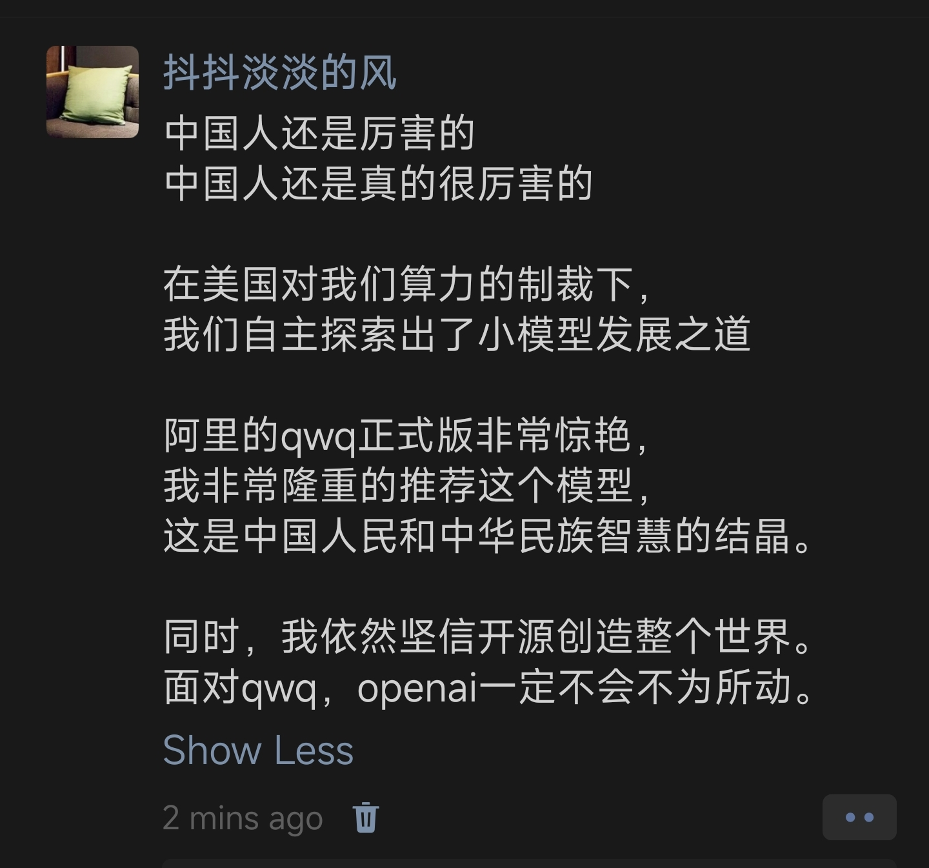
NathMath @ Bilibili

Slide 18

YES!
NathMath @ Bilibili

Slide 19
附录：六边形弹球代码
import numpy as np
import matplotlib.pyplot as plt
from matplotlib.animation import FuncAnimation
from matplotlib.patches import Circle, Polygon
class Ball:
def __init__(self, position, velocity, radius, mass=1.0):
self.pos = np.array(position, dtype=float)
self.vel = np.array(velocity, dtype=float)
self.radius = radius
self.mass = mass
def update(self, acceleration, dt):
self.vel += acceleration * dt
self.pos += self.vel * dt
def create_hexagon(center, radius, angle_rotation=0.0):
theta = np.linspace(0, 2*np.pi, 7)[:-1] + angle_rotation
x = center[0] + radius * np.cos(theta)
y = center[1] + radius * np.sin(theta)
return np.c_[x, y]
def line_segment_point_distance(A, B, P):
AP = P - A
AB = B - A
t = np.dot(AP, AB) / np.dot(AB, AB)
if t < 0:
closest = A
elif t > 1:
closest = B
else:
closest = A + t * AB
dist = np.linalg.norm(P - closest)
return dist, closest
def check_collision(ball, edges, center):
min_dist = float('inf')
collision_edge = None
collision_point = None
normal_dir = None
for edge in edges:
A, B = edge
dist, closest = line_segment_point_distance(A, B, ball.pos)
if dist < ball.radius and dist < min_dist:
min_dist = dist
collision_edge = edge
collision_point = closest
if collision_edge is not None:
A, B = collision_edge
AB = B - A
normal_dir = np.array([-AB[1], AB[0]]) # 初始法线方向
normal_dir /= np.linalg.norm(normal_dir)
# 调整法线方向指向多边形内部
M = (A + B) / 2
OM = M - center
if np.dot(normal_dir, OM) < 0:
normal_dir *= -1.0
return True, collision_point, normal_dir
else:
return False, None, None
def handle_collision(ball, normal_dir, collision_point, e=0.99, mu=0.1):
v = ball.vel
vn = np.dot(v, normal_dir)
vt = v - vn * normal_dir
v_new_normal = -e * vn * normal_dir
v_new_tangent = vt * mu # 摩擦系数减小切向速度
new_vel = v_new_normal + v_new_tangent
ball.vel = new_vel
# 调整球的位置到碰撞点外侧（法线方向指向内部时需要反向）
ball.pos = collision_point - normal_dir * ball.radius # 关键修正：方向改为反向
def main():
hex_center = np.array([0.0, 0.0])
hex_radius = 100.0
rotation_speed = 0.15 # 六边形旋转角速度（弧度/秒）
theta = 0.0
fig, ax = plt.subplots()
ax.set_xlim(-hex_radius*1.2, hex_radius*1.2)
ax.set_ylim(-hex_radius*1.2, hex_radius*1.2)
ax.set_aspect('equal')
# 初始化六边形
vertices = create_hexagon(hex_center, hex_radius, theta)
hex_patch = Polygon(vertices, fill=False, edgecolor='blue')
ax.add_patch(hex_patch)
ball = Ball([0, 50], [5, -10], radius=5)
circle = Circle(ball.pos, ball.radius, color='red')
ax.add_patch(circle)
dt = 0.01 # 时间步长
g = np.array([0, -9.8]) # 重力加速度
def animate(frame):
nonlocal theta, ball
# 更新旋转角度
theta += rotation_speed * dt
# 重新计算顶点和边
vertices = create_hexagon(hex_center, hex_radius, theta)
edges = []
for i in range(len(vertices)):
A = vertices[i]
B = vertices[(i+1)%len(vertices)]
edges.append((A, B))
# 更新六边形图形
hex_patch.set_xy(vertices)
# 物理更新
acceleration = g
ball.update(acceleration, dt)
# 检测碰撞
collision, collision_point, normal_dir = check_collision(ball, edges, hex_center)
if collision:
handle_collision(ball, normal_dir, collision_point)
# 防止球体完全脱离可视区域
if np.linalg.norm(ball.pos) > hex_radius * 1.5:
ball.pos = np.array([0, 50]) # 重置位置
ball.vel = np.array([5, -20]) # 重置速度
circle.center = ball.pos
return circle, hex_patch
anim = FuncAnimation(fig, animate, frames=20000, interval=1, blit=True)
plt.show()
if __name__ == "__main__":
main()
NathMath @ Bilibili

Slide 20
附录：雨降代码
import pygame
import random
import math
import numpy as np
# 初始化Pygame
pygame.init()
# 设置窗口尺寸
WIDTH, HEIGHT = 800, 600
screen = pygame.display.set_mode((WIDTH, HEIGHT))
pygame.display.set_caption("Realistic Rain Simulation with Poisson Process")
# 创建拖尾表面
trail_surface = pygame.Surface((WIDTH, HEIGHT), pygame.SRCALPHA)
# 物理参数
GRAVITY = 0.25 # 重力加速度
LAMBDA_RAIN = 90.0 # 每秒生成雨滴数（泊松过程强度）
DECAY_RATE = 0.98 # 拖尾衰减系数（0.98表示保留98%透明度）
raindrops = []
def random_color():
"""生成淡蓝色透明颜色"""
r = random.randint(0, 50)
g = random.randint(0, 50)
b = random.randint(100, 255)
a = random.randint(50, 150)
return (r, g, b, a)
# 泊松过程初始化
current_time = pygame.time.get_ticks()
next_spawn_time = current_time + (-math.log(random.random()) / LAMBDA_RAIN) * 1000
clock = pygame.time.Clock()
running = True
while running:
for event in pygame.event.get():
if event.type == pygame.QUIT:
running = False
# 清除旧的拖尾（保持透明度衰减）
trail_array = pygame.surfarray.pixels_alpha(trail_surface)
trail_array[:] = (trail_array * DECAY_RATE).astype(trail_array.dtype)
del trail_array
screen.fill((0, 0, 50)) # 深蓝色背景
current_time = pygame.time.get_ticks()
# 检查是否生成新雨滴（泊松过程判断）
if current_time >= next_spawn_time:
# 生成新雨滴
x = random.randint(0, WIDTH)
y = 0 # 从屏幕顶部开始
speed = 0
color = random_color()
radius = random.randint(2, 4)
raindrops.append({
'x': x,
'y': y,
'speed': speed,
'color': color,
'radius': radius
})
# 计算下次生成时间间隔（指数分布）
interval = (-math.log(random.random()) / LAMBDA_RAIN) * 1000
next_spawn_time = current_time + interval
# 更新雨滴位置和状态
to_remove = []
for drop in raindrops:
drop['speed'] += GRAVITY
drop['y'] += drop['speed']
# 超出屏幕时移除
if drop['y'] > HEIGHT:
to_remove.append(drop)
# 绘制到拖尾表面
pygame.draw.circle(trail_surface, drop['color'],
(drop['x'], int(drop['y'])), drop['radius'])
# 移除超出屏幕的雨滴
for dr in to_remove:
raindrops.remove(dr)
# 绘制所有元素
screen.blit(trail_surface, (0, 0))
pygame.display.flip()
clock.tick(60)
pygame.quit()
NathMath @ Bilibili

Slide 21
附录：烟花代码
import numpy as np
import matplotlib.pyplot as plt
from matplotlib.animation import FuncAnimation
# Simulation parameters
num_particles = 1000
gravity = 9.8
drag_coefficient = 0.05
dt = 0.1
max_speed = 100
delay_frames = 50 # Time to reach explosion height
lifetime = 150 # Frames after explosion
total_frames = delay_frames + lifetime
fig_size = 800 # Plot limits (larger to see ascent)
# Particle initialization
x = np.zeros(num_particles)
y = np.zeros(num_particles)
vx = np.zeros(num_particles)
vy = np.zeros(num_particles)
colors = np.zeros((num_particles, 4))
colors[:, :3] = np.random.uniform(0.7, 0.9, (num_particles, 3)) # Bright colors
colors[:, 3] = 1.0 # Full opacity
sizes = np.random.uniform(10, 30, num_particles)
current_sizes = sizes.copy()
age = np.zeros(num_particles, dtype=int)
# Main firework rocket parameters
main_x = 0.0
main_y = 0.0
main_vx = 0.0
main_vy = 90.0 # Initial upward velocity
main_gravity = gravity
# Setup figure and axis
fig, ax = plt.subplots(figsize=(10, 10))
ax.set_aspect('equal')
ax.set_xlim(-fig_size, fig_size)
ax.set_ylim(-fig_size, fig_size)
ax.axis('off')
ax.set_facecolor('#040404') # Darker background
# Initialize scatter plot
scat = ax.scatter(x, y, s=current_sizes, c=colors, edgecolor='white', linewidth=0.5)
def update(frame):
global main_x, main_y, main_vx, main_vy, x, y, vx, vy, colors, age, current_sizes
if frame < delay_frames:
# Rocket ascent phase
main_ax = 0.0
main_ay = -main_gravity # Gravity acting on rocket
main_vx += main_ax * dt
main_vy += main_ay * dt
main_x += main_vx * dt
main_y += main_vy * dt
# Keep particles at rocket position until explosion
x[:] = main_x
y[:] = main_y
vx[:] = 0.0
vy[:] = 0.0
colors[:,3] = 1.0 # Full opacity during ascent
current_sizes[:] = sizes # Full size
else:
# Explosion phase
if frame == delay_frames:
# Initialize particles at explosion position
theta = np.random.uniform(0, 2*np.pi, num_particles)
speed = np.random.uniform(0, max_speed, num_particles)
vx = speed * np.cos(theta)
vy = speed * np.sin(theta)
x[:] = main_x
y[:] = main_y
age[:] = 0
# Apply physics to particles
ax = -drag_coefficient * vx
ay = -gravity - drag_coefficient * vy
vx += ax * dt
vy += ay * dt
x += vx * dt
y += vy * dt
# Update aging and fading
age += 1
alpha = np.clip(1 - (age / lifetime), 0, 1)
colors[:,3] = alpha
current_sizes = sizes * alpha * 0.8
# Add sparkles (random brightening)
if np.random.rand() < 0.1:
idx = np.random.choice(num_particles, 5)
colors[idx, 3] = 1.0
# Update plot elements
scat.set_offsets(np.c_[x, y])
scat.set_facecolors(colors)
scat.set_sizes(current_sizes)
return (scat,)
# Create animation
ani = FuncAnimation(fig, update, frames=total_frames, interval=10, blit=True)
plt.show()
NathMath @ Bilibili

