Slide 1
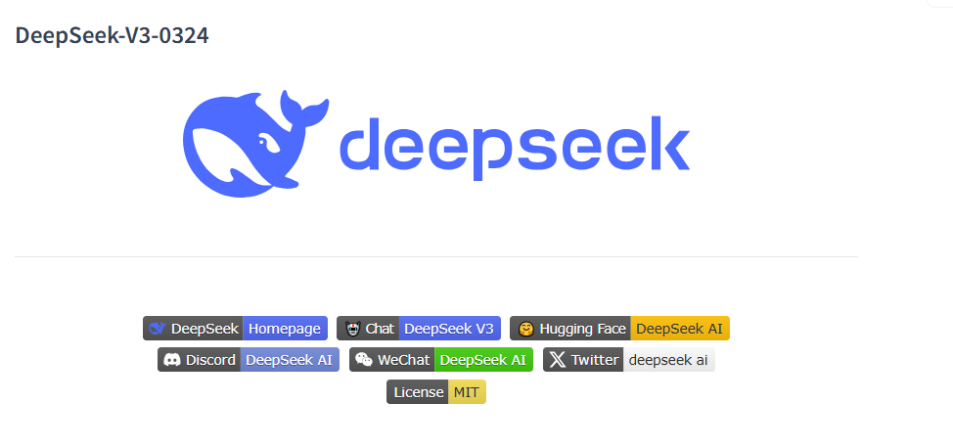
惊喜，但请保持理性
NathMath @ Bilibili

Slide 2
先说结论
· DeepSeek V3更新了新的版本0324，通过训练
了R1生成的推理链内容显著提高了推理能力
· 模型架构完全不变，在嵌入上略微修改了架构
· 数学和逻辑推理能力逼近R1水平，但代价是
冗长的推理链变为了直接的output(但便宜了)
· 并未衰减其他输出能力，Agent能力大幅提升
这主要是因为V3采用了MoE多专家的架构
NathMath @ Bilibili

Slide 3
内容导视
· 怎么使用？
· 官方评测的解读
· 原创NM-GRE52的评测结果
· 数学和逻辑推理演示和建议
· Agent代理的演示和建议
NathMath @ Bilibili

Slide 4
怎么使用？
DeepSeek官网已经接入了升级版V3
DeepSeek API已经支持了升级版的V3
Hugging Face Inference Providers 在线推理
NathMath @ Bilibili

Slide 5
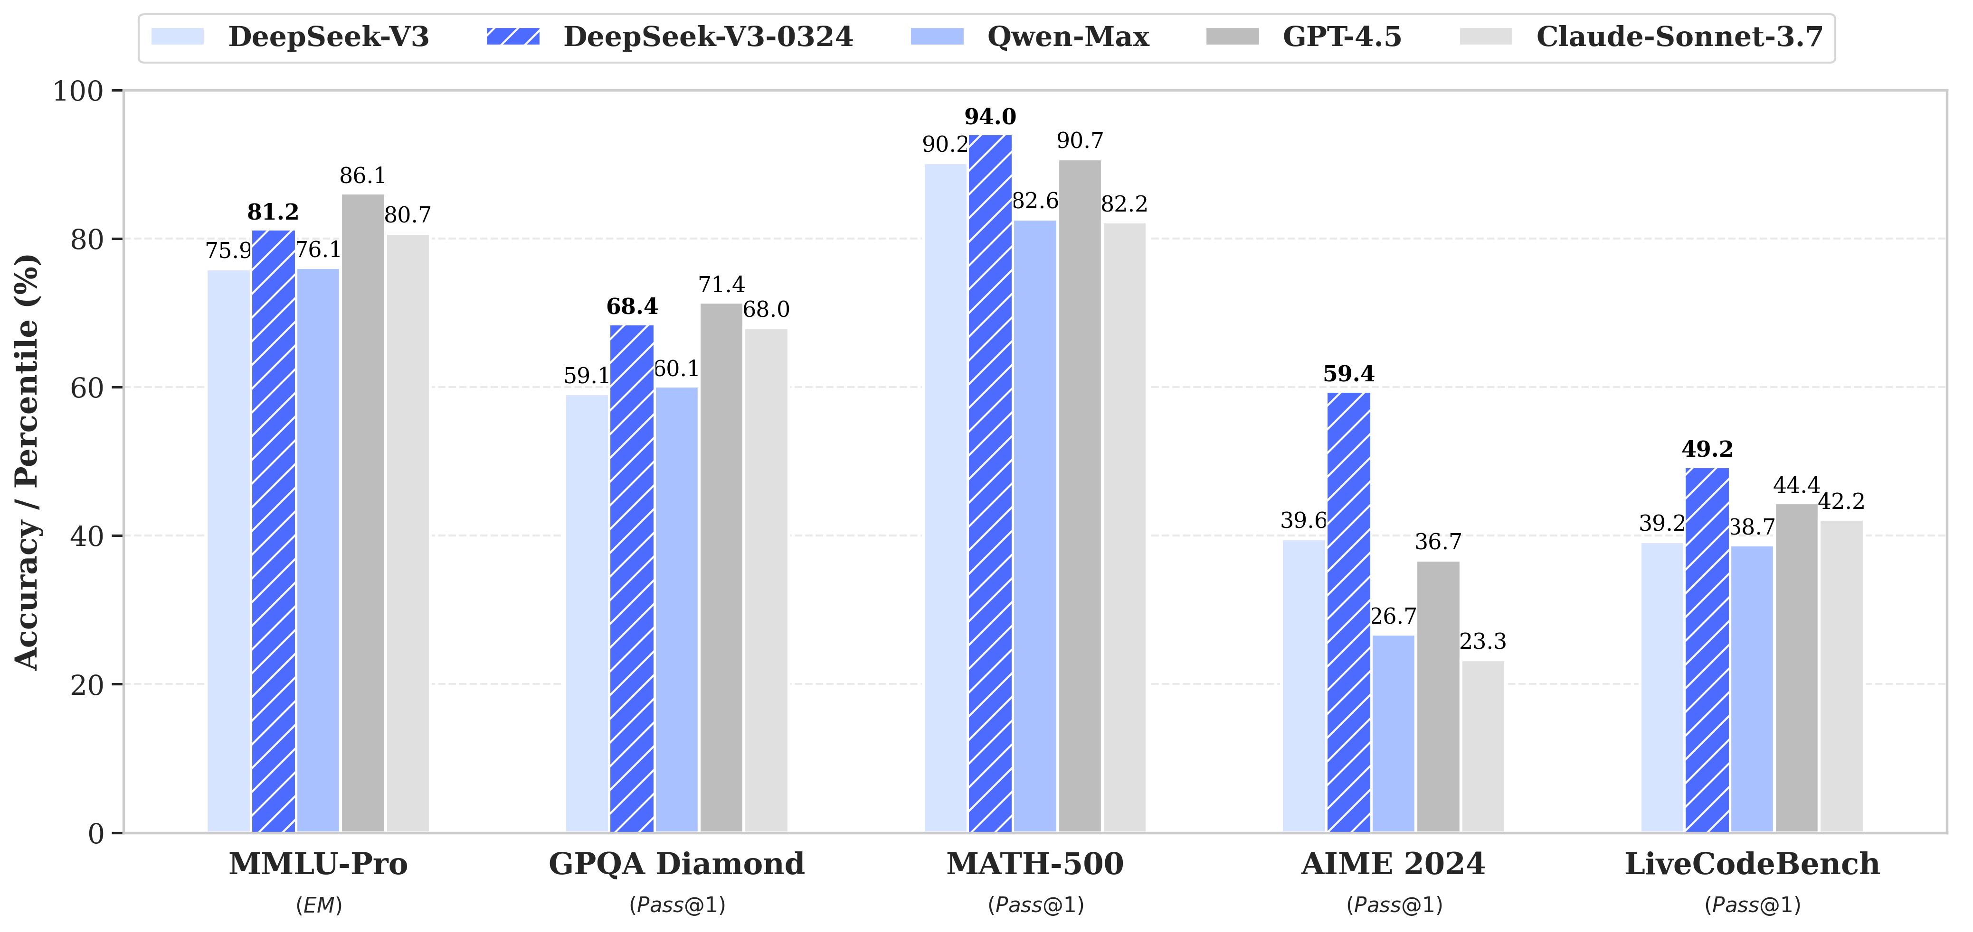
官方评测的解读
NathMath @ Bilibili

Slide 6
NM-GRE52的评测结果
NM-GRE52 是一套难度具有梯度的全新数学推理测试习题集，其包含了由我改编/原创的具有GRE(美国研考)考试风格的数学/推理题。特点在于：
· 所有题目/答案全部开源
· 强抗过拟合， 70%以上的题目是原创/改编
· 难度具有梯度，简单题(40%)，中等题(40%)，难题(10%)，特难题(10%)，能够评测模型综合能力
NathMath @ Bilibili

Slide 7
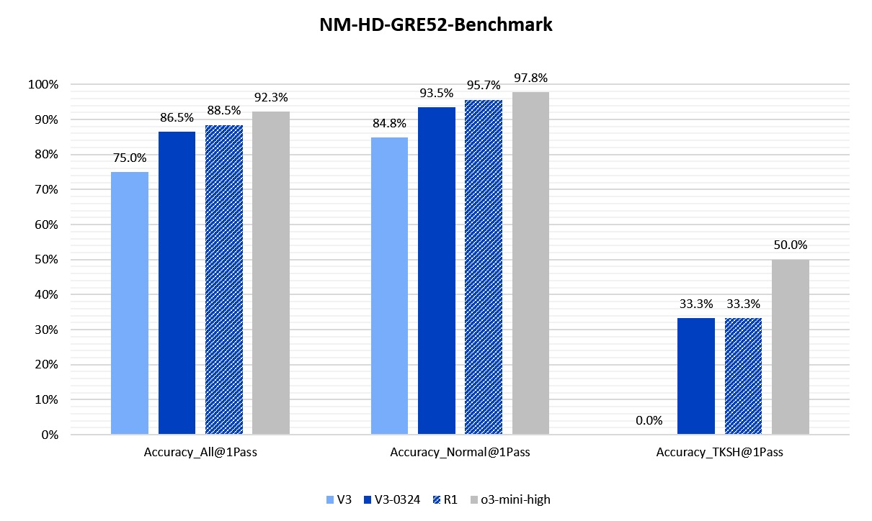
NM-GRE52的评测结果
NathMath @ Bilibili

Slide 8
数学逻辑推理演示和建议
数学和逻辑推理评测：
· 天梯图：o3-mini-high > R1 >= V3-0324
>= o1-mini >= QWQ >> V3 >> GPT4o
· 主要的提升在于训练了R1生成的推理链内容
· MoE机制能够识别需要推理的内容，适时调用推理
· MoE机制能够保持非推理能力的不下降
· # 但推理链的内容作为输出，使得输出更加冗长
NathMath @ Bilibili

Slide 9
数学逻辑推理演示和建议
数学和逻辑推理测试：
案例： NM-GRE52的测试实际情况
简单数学问答(比大小/解方程)的测试
复杂金融问题(q-Quant)的解决测试
NathMath @ Bilibili

Slide 10
Agent代理的评测和建议
Agent代理能力测试：
· 天梯图：GPT 4.5 > V3-0324 > GPT4o >> any other
· Increased accuracy in Function Calling, fixed issues.
· 个人认为V3-0324的工具调用能力得到了大幅提升
· 能够高正确率选择和调用适当工具
· 能够高正确率地编写代码进一步自动化
· 考虑到定价(虽然慢了点)它是构建Agent的不二之选
NathMath @ Bilibili

Slide 11
Agent代理的评测和建议
Agent代理能力测试：
案例： 简单的搜索问题
简单的文件系统控制问题
复杂的程序编写和自主纠错问题
复杂的文件系统控制问题(复杂的文件检索)
NathMath @ Bilibili

Slide 12
Agent代理的评测和建议
Agent代理能力测试：
搜索"spl phonitor mini"。这应该是一个耳机放大器，帮我详细的总结它的功能/价格/创新点/评价。
使用visit功能访问这个文件夹”C:\Users\T15P\Music\NCM”寻找一首名叫”只此一方”的歌，打印其文件地址。
我现在希望进行期权定价。我想要对一个亚式期权定价。该期权的基础资产服从
dS = r(t)Sdt + v(t)SdW(t) 其中r(t)和v(t)均是随机过程，r(t)和v(t)均服从CIR过程。
使用Python进行带Variance Reduction的Monte Carlo定价。
你可以自己尝试调用工具执行代码，并输出没有报错的代码。
你需要写一个python代码，调用工具执行python代码，并告诉我结果。代码需要：
在”D:\Netease\Download”这个目录里寻找NathMath歌手的”彼方”这首歌。注意，
你可能会找到多个相似的歌曲，我要求你的代码能够处理多个匹配的文件，然后打印。你可以使用正则表达式匹配。
NathMath @ Bilibili

Slide 13
附录：NM-GRE52的测试题库
Selected GRE problems have been modified to be harder for testing purposes.
[NathMath@Bilibili]
[Open-sourced under Apache 2.0 License]
1. "Sixty-eight people are sitting in 20 cars and each car contains at most 4 people. What is the maximum possible number of cars that could contain exactly 1 of the 68 people?"
The options provided are:
2
3
4
8
12
Ans: 4
2. "If n is any prime number greater than 2, which of the following CANNOT be a prime number?"
Options:
n - 4
n - 3
n - 1
n + 2
n + 5
3 * n
Ans: n + 5, 3 * n
3. In 1988 Mr. Smith's annual income was greater than Mrs. Smith's annual income. In 1989 Mr. Smith's annual income decreased by p percent, whereas Mrs. Smith's annual income increased by p percent. (p > 0)
Which one is greater?
Column A
Mr. and Mrs. Smith's combined annual income in 1988
Column B
Mr. and Mrs. Smith's combined annual income in 1989
Column C
Equal
Ans: A
4. How many integers between 101 and 201 are equal to the square of some integer?
Options:
Two
Three
Four
Five
Six
Ans: Four
5. The price of a certain stock was 12 1/2 dollars per share. The price increased x percent to 15 5/8 dollars per share.
Which one is greater?
Column A
x
Column B
20
Column C
Equal
Ans: A
6. The "reflection" of a positive integer is obtained by reversing its digits. For example, 321 is the reflection of 123. The difference between a five-digit integer and its reflection must be divisible by which of the following?
Options:
2
4
5
6
9
Ans: 9
7. The original value of machine X is V dollars, while the original value of machine Y is 2V dollars. Both machines depreciate in value at a constant rate of 10 percent of their original value per year.
Which one is larger?
Column A
The value of machine X after 3 years
Column B
The value of machine Y after 6 years
Ans: B
8. If n is an odd integer, which of the following is the square of the next larger odd integer?
Column A n^2 + 1
Column B n^2 + 4
Column C n^2 + 2n + 1
Column D n^2 + 4n + 4
Column E n^2 + n + 1
Ans: D
9. If 55 percent of a group of people have brown hair and 80 percent of the same group do not have red hair, what fraction of those who do not have brown hair have red hair?
Options:
1/4
4/11
4/9
5/9
4/5
Ans: 4/9
10. The expression is:
$$n = \frac{k + \frac{r}{s}}{\frac{t}{v}}$$
In the equation above, k, r, s, t, and v represent positive numbers. Multiplying which one of these numbers by 2 will reduce the value of n to 1/2 of its present value?
Options:
k
r
s
t
v
Ans: t
11. A certain money market account that had a balance of $48,000 during all of last month earned $360 in interest for the month. At what simple annual interest rate did the account earn interest last month?
Options:
7%
7.5%
8%
8.5%
9%
Ans: 9%
12. When the even integer n is divided by 7, the remainder is 3.
Select the one that is correct.
Column A
The remainder when n is divided by 14 is larger than 10
Column B
10 is larger than the remainder when n is divided by 14
Column C
Equal
Ans: C
13. {x} represents the greatest integer less than or equal to x and [x] represents the least integer greater than or equal to x.
Which one is greater?
Column A
({1.4} + [1.4]) / 2
Column B
1.4
Column C
Equal
Ans: A
14. S is a set of n consecutive integers.
Which one is greater?
Column A
The mean of S
Column B
The median of S
Column C
Equal
Ans: C
15. An airline must charge an 11 percent tax on the price of an airline ticket. The airline wishes to charge the whole-dollar amount of $433.00 for the ticket, including the tax. What price, to the nearest $0.01, should the airline set for the ticket before the tax is added?
Options:
$385.37
$389.70
$390.09
$393.64
$422.00
Ans: $390.09
16. From the set of 6 letters A, B, C, D, E, and F, there are 20 different 3-letter subsets that could be selected.
Which one is greater?
Column A
The number of 3-letter subsets that include the letter F
Column B
10
Column C
Equal
Ans: C
17. If (7, 3) is the center of the circle, the circle have to intersection points with X axis, and it does not have any intersection point with Y axis, then the radius of the circle could be equal to which of the following?
Options:
2
4
5
7
9
Ans: 4, 5
18. If x + 2y = 2 and (x + y)² = 9, which of the following is a possible value of y?
Options:
-9
-5
-3/2
3/2
5
Ans: 5
19. The curvature of a circle is defined to be the reciprocal of the radius of the circle.
Which one is greater?
Column A
The curvature of a circle with circumference 35π
Column B
The curvature of a circle with circumference 36π
Column C
The curvature of a circle with area of 307π
Ans: A
20. A standard deck of 52 cards is shuffled and one card is drawn. What is the probability that the card is an ace or a face card?
2/13
3/13
4/13
6/13
7/13
Ans: 4/13
21. a is a positive integer.
Quantity A
(3a)*(3a)/3
Quantity B
(3a + 3a)/3
Options:
A. Quantity A is greater.
B. Quantity B is greater.
C. The two quantities are equal.
D. The relationship cannot be determined from the information given.
Answer: A
22. In Country Z, the ratio of residents under 25 years of age to residents 25 years or older is 3 to 2. If there are 36 million people under 25 years of age residing in Country Z, how many people reside in Country Z, in millions?
Options:
18
24
36
48
60
Ans: 60
23. P, Q, and R are three points in a plane, and R does not lie on line PQ. Which of the following is true about the set of all points in the plane that are the same distance from all three points?
Options:
A. It contains no points.
B. It contains one point.
C. It contains two points.
D. It is a line.
E. It is a circle.
Ans: B
24. A student made a conjecture that for any integer n, the integer 4n + 3 is a prime number. How many values of n that is greater than 3 and less than 49 could be used to disprove the student's conjecture?
Ans: 4
[Tricky]
25. A random variable Y is normally distributed with a mean of 200 and a standard deviation of 10.
Quantity A:
The probability of the event that the value of Y is greater than 215
Quantity B:
0.06
Options:
A. Quantity A is greater.
B. Quantity B is greater.
C. The two quantities are equal.
D. The relationship cannot be determined from the information given.
Ans: A
26. How many unique real solutions does this function have?
X^3 - X^2 - X + 1 = 0
Options:
0
1
2
3
4
5
6
Ans: 2
27. X is an integer that is greater than 1.
Quantity A:
2025^(2024 + X)
Quantity B:
2024^(2025 + X)
Options:
A. Quantity A is greater.
B. Quantity B is greater.
C. The two quantities are equal.
D. The relationship cannot be determined from the information given.
Ans: B
28. x^y > 0, x(y^2) < 0
Quantity A:
x
Quantity B:
y
Options:
A. Quantity A is greater.
B. Quantity B is greater.
C. The two quantities are equal.
D. The relationship cannot be determined from the information given.
Ans: D
29. r, s, and t are three consecutive odd integers such that r < s < t.
Quantity A:
r + s + 3
Quantity B:
s + t - 1
Options:
A. Quantity A is greater.
B. Quantity B is greater.
C. The two quantities are equal.
D. The relationship cannot be determined from the information given.
Ans: C
30. What is the unit digit of 17^2025?
Options:
1
3
5
7
9
Ans: 7
31. For number 101^11,what is the total number of zeros (digits of "0") in the number?
Options:
0
1
2
3
4
5
6
7
Ans: 1
34. If a < b < 0, which of the following numbers must be positive? Select all such numbers.
Options:
A. a - b
B. a² - b²
C. ab
D. a²b
E. a² + ab²
F. a² - a²b
Ans: BCF
35. Eight points are equally spaced on a circle. If 4 of the 8 points are to be chosen at random, what is the probability that a quadrilateral having the 4 points chosen as vertices will be a square?
Options:
A. 1/70
B. 1/35
C. 1/7
D. 1/4
E. 1/2
Ans: B
36. The range of the heights of the female students in a certain class is 13.2 inches, and the range of the heights of the male students in the class is 15.4 inches. Which of the following statements individually provide(s) sufficient additional information to determine the range of the heights of all the students in the class? Indicate all such statements.
Options:
A. The shortest male student is 62 inches and the shortest female student is 54 inches.
B. The tallest male student in the class is 5.8 inches taller than the tallest female student in the class.
C. The median height of the male students in the class is 1.1 inches greater than the median height of the female students in the class.
D. The average (arithmetic mean) height of the male students in the class is 4.6 inches greater than the average height of the female students in the class.
Ans: AB
[Super Hard]
37. Given a 5L bucket and a 9L bucket, try to determine a sequence of operations to measure exactly 7L of water into the 9L bucket using as little waste as possible. You have unlimited water available. You may either empty a bucket completely or pour water from one bucket into the other until one bucket is either empty or the other is full; no other measurements are allowed. Question: What is the minimum waste?
Options:
A. 12
B. 13
C. 14
D. 15
E. 16
F. 18
G. 19
H. 20
Ans: D
38. How many times, on average, do I have roll a dice until every single number appears at least once? Give me the number as the answer?
Ans: 14.7
[Super Hard]
39. A and B choose numbers from 1 to 1000, with one going first and another second. They cannot select a factor of a number that has already been chosen. The person who first has no numbers left to choose loses. Indicate all such statements.
Options:
A. If A first selects, then A will probably but not defintely win.
B. If A first selects, then A will definitely win.
C. If A first selects, then A will definitely lose.
D. If B first selects, then the probability that B will lose is below 25%.
E. If B first selects, then the probability that B will lose is above 50%.
Ans: BD
40. Of the 20 lightbulbs in a box, 2 are defective. An inspector will select 4 lightbulbs simultaneously and at random from the box. What is the probability that neither of the lightbulbs selected will be defective? Give your answer as a fraction.
Ans: 12/19
41. If \( \frac{1}{(2^{17} \cdot 5^{19})} \) is expressed as a terminating decimal, how many nonzero digits will the decimal have?
Options:
A. One
B. Two
C. Four
D. Six
E. Eleven
Ans: A
42. The number of two-digit positive integers for which the units digit is not equal to the tens digit.
Ans: 81
43. A die is thrown for 10 times. Let M and m denote the maximum and minimum points obtained. Find the probability that m = 2 and M = 5. Select the answer nearest to the probability you calculated:
Options:
A. 1/6
B. 1/55
C. 1/65
D. 1/75
E. 2/3
F. (2/3)^10
Ans: C
44. m=2025^2024+2023, when m is divided by 1999, the remainder is r.
Quantity A: r
Quantity B: 42
Options:
A. Quantity A is greater.
B. Quantity B is greater.
C. The two quantities are equal.
D. The relationship cannot be determined from the information given.
Ans: B
45. In a single line of people waiting to purchase tickets for a movie, there are currently 8 people behind Shandra. If 3 of the people who are currently in line ahead of Shandra purchase tickets and leave the line, 7 of people who are interested in and join the line behind Shandra, and no one else leaves the line, there will be totally 1/3 more people than the line used to be. How many people are in the line before the change?
Ans: 12
46. Each of the following equations defines y as a function of x for all integers x from -100 to 100. For which of the following equations is the standard deviation of the y-values corresponding to all the x-values the greatest?
Options:
A. y = x + 2025
B. y = 255/11x
C. y = 1/2x^2
D. y = 1/3x^2 + 1/2x
E. y = 1/2x^2 - 1/3x
Ans: E
47. Between 1997 and 2077, inclusive, how many leap years are there that are not divisible by 20?
Options:
A. 10
B. 12
C. 14.
D. 16
E. 18
F. 20
Ans: D
48. Of the students in a school, 20 percent are in the science club and 30 percent are in the band. If 25 percent of the students in the school are in the band but are not in the science club, what percent of the students who are in the science club are not in the band?
Options:
A. 5%
B. 20%
C. 25%
D. 60%
E. 75%
Ans: E
49. In a certain medical group, Dr. Schwartz schedules appointments to begin 30 minutes apart, Dr. Ramirez schedules appointments to begin 25 minutes apart, and Dr. Wu schedules appointments to begin 50 minutes apart. All three doctors schedule their first appointments to begin at 8:00 in the morning, which are followed by their successive appointments throughout the day without breaks. Other than at 8:00 in the morning, at what times before 1:30 in the afternoon do all three doctors schedule their appointments to begin at the same time?
Indicate all such times
Options:
A. 9:30 in the morning
B. 10:30 in the morning
C. 11:30 in the morning
D. 12:00 noon
E. 1:00 in the afternoon
Answer: BE
[Super Hard]
50. From the digits 1, 2, 3, 4, 6, 7, 8, 9, 0 choose 4 digits to form a number less than 10000 without repeating any digit. The probability that this number is even and is divisible by 4 is?
Options:
A. 1/3
B. 5/18
C. 4/15
D. 1/4
E. 1/5
Ans: B
[Super Hard]
51. Consider a 5x5 light-out game, rules: Each cell represents a light, and each light has two states: on and off. The initial state has some lights on and some lights off. Specifically, lights at (1,1), (1,2), (2,2), (2,3), (3,3), (3,4), (4,4), (4,5), (5,5) are initially on. Remember, clicking on any cell can change the state of that cell and its neighboring cells.
Find the strategy with the least number of clicks to turn off all the lights. What is the number of clicks you have to do before turning off all the lights?
Options:
A. 7
B. 9
C. 10
D. 11
E. 13
F. 16
Ans: E
[Super Hard]
52. We have a list of digits (1,1,2,2,3,3,4,4,5,5). Permute them into a number N, and N should satisfy: one digit between two 1s, two digits between two 2s, three digits between two 3s, four digits between two 4s, and three digits between two 5s. How many Ns that are satisfied?
Options:
A. 0
B. 1
C. 2
D. 3
E. 4
Ans: A
NathMath @ Bilibili

Slide 14
欢迎DeepSeek干翻OpenAI垄断妄想
NathMath @ Bilibili

